Slide 1
Modul Pembelajaran [Kode Modul]
[NAMA MODUL]
Page ini diisi oleh Telkom
Pathway | :
Sub Pathway | :
Kompetensi | :
Key Element | :
Level | :
Developer | :
Approval | : | 1. Mgr Learning Development 2. SM School of Dig Platform & Service
Sesuai Dirkom-10
Nama/ NIK/ Bidang
Atau Nama Vendor
Rev. : 00
Created/Last Modified : 10-2021

Slide 2
Modul Pembelajaran | : | React States
Deskripsi Modul | : | State adalah objek React yang digunakan untuk memuat data atau informasi tentang komponen. State component dapat berubah seiring waktu; dan setiap kali ia berubah, komponen dapat di render ulang.
Enabling Learning Objective | : | Memahami tentang React States, bagaimana definisikan nya, dan mengganti nya dalam komponen
Daftar Topik | : | Defining the State Changing the state
Searching Keyword | : | ReactJS States class constructor props setState this.setState( )

Slide 3



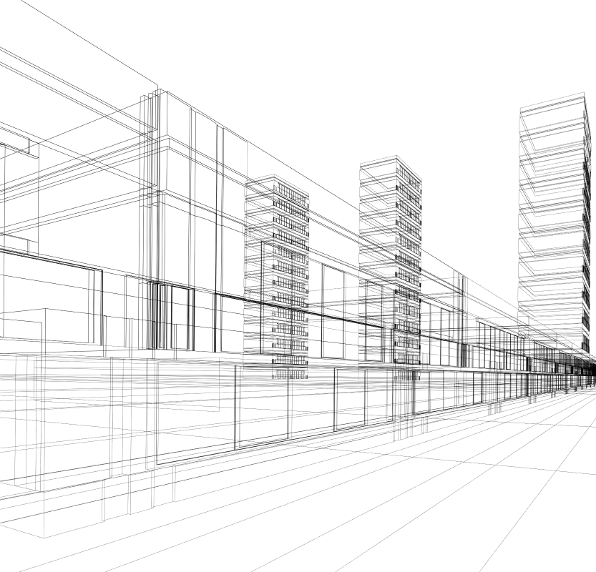
REACTJS
React States
Calvin Susanto Putra

Slide 4
Table of Contents
Defining the state
Changing the state

Slide 5

Defining the state
A state can be modified based on user action or network changes
Every time the state of an object changes, it re-renders the component to the browser
The state object is initialized in the constructor and can store multiple properties
Facebook - github.com

Slide 6
Defining the state
this.setState() method is used to change the value of the state object, as well as perform a shallow merge between the new and the previous state
States are classified as a form of Hooks in React; methods that allow components to use React’s inbuilt features without a class constructor
Facebook - github.com

Slide 7
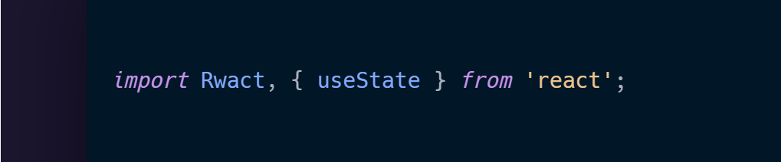
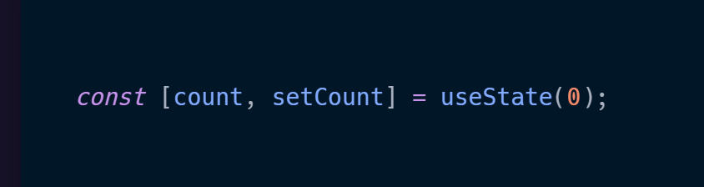
Defining the state
The setState( ) method must first be imported:
It must then be declared within the component:

Slide 8
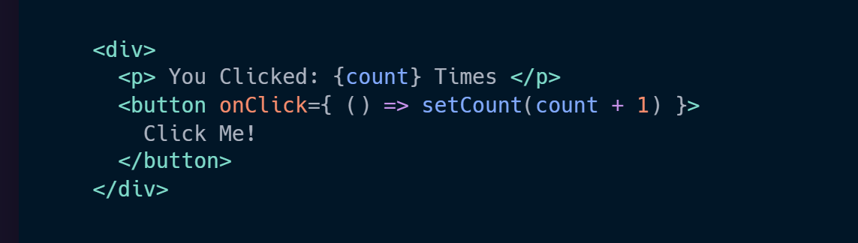
Defining the state
Only then can the setState method be called to perform a logical task in a component:

Slide 9

Changing the state
as stated before, the setState() method is used to change the value of an object
calling or utilizing setState re-renders the entire component and its child components automatically, eliminating the need to use the render function
changing or updating the state requires the ‘this.setState’ method, serving as a marker on how a component should respond
Patterns - patterns.dev

Slide 10
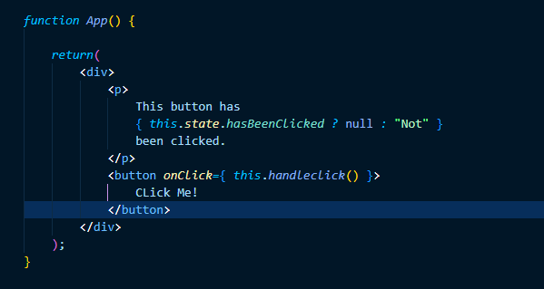
Changing the state
Take this example of a state being used to update a component:

Slide 11
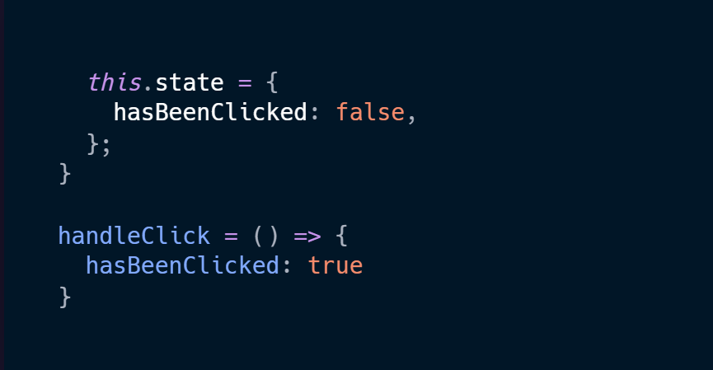
Changing the state
The state relies on the following utility functions to run properly and render the new value:
The above functions could be written in a class constructor or App.js function itself

Slide 12
Changing the state
when a state gets updated, only the value or property of that state gets passed in, allowing for two boolean values in different functions to merge
however, this only occurs in the first-level, which means that only one specific value gets updated whilst the rest are overwritten
Patterns - patterns.dev

Slide 13
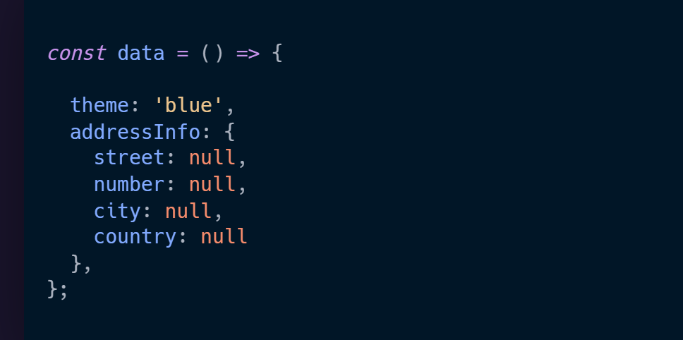
Changing the state
An example of state-handling using an array, where the array stores a set of data:

Slide 14
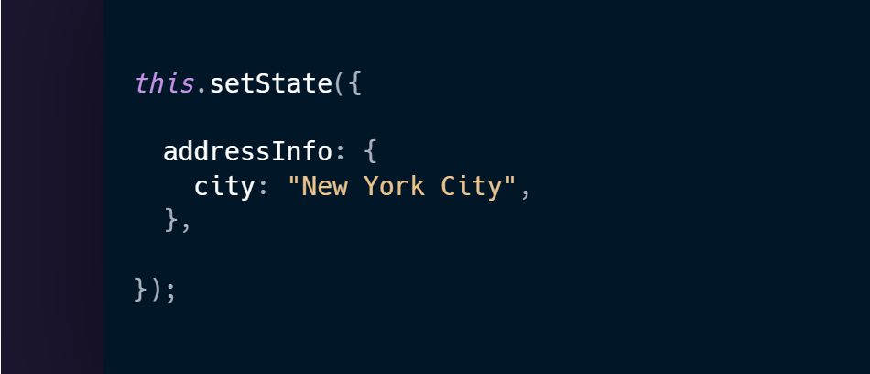
Changing the state
Let’s say we want to update ‘addressInfo’, To merge the data requires the ‘this.setState( )’ method:

Slide 15
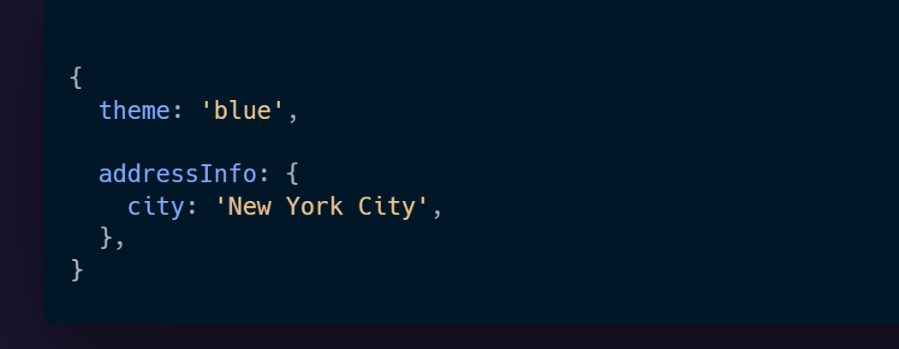
Changing the state
This updates the selected child value (addressInfo) and overwrites the others:

Slide 16
References
https://reactjs.org/docs/state-and-lifecycle.html
https://reactjs.org/docs/hooks-state.html
https://www.patterns.dev/posts/reactjs/
https://learn.co/lessons/react-updating-state

Slide 17
REACTJS
React States
Calvin Susanto Putra

Slide 18
Kelengkapan Modul
Pre & Post Test (minimal 10 soal, pilihan ganda a-d)
Pre Reading
Teaching Notes
Referensi

Slide 19
Assessment – [Pre & Post Test]

Slide 20

Pre-Reading
ReactJS is a Javascript library for building user interfaces. This PDF ebook is a portable offline reference guide for the community, can be printed or synced with your kindle for a better reading experience. It's based on ReactJS version v.16.13.1
This is an excellent reference format for ReactJS beginners, is not a tutorial just the official documentation for your reference

Slide 21
TEACHING NOTES*
Lesson/Topics
Case Study
Clips
Games
Others : . . . . . . . . . . . .
OBJECTIVES
PERSIAPAN
Memahami tentang React States, bagaimana definisikan nya, dan mengganti nya dalam komponen
Offline: Laptop
Online: Link Zoom
OVERVIEW
DIRECTION
State adalah objek React yang digunakan untuk memuat data atau informasi tentang komponen. State component dapat berubah seiring waktu; dan setiap kali ia berubah, komponen dapat di render ulang.
Menjelaskan definisi nya atas States di React
.
Menjelaskan state-handling dengan metode React (this.setState, setState)
Demonstrasikan metode untuk mengguna setState buat komponen
Mengatur dan mengelola arah dan jalan-nya diskusi;
Memberikan contoh-contoh, kasus dan ilustrasi;
Memberikan apresiasi dalam tanya jawab;
Memberikan debrief atau insight/pesan dari kegiatan;
Memberikan dan menyampaikan kesimpulan dan di tiap sesi atau di akhir sesi
PERALATAN YANG DIBUTUHAN
Offline : Laptop
Online: Link Zoom
*Catatan : jumlah halaman teaching Note dapat ditambah seauai kebutuhan

Slide 22
TEACHING NOTES 2/2*
DIRECTION
Section (slide/clip/case/etc) | Activities (Hal apa yang akan dilakukan untuk setiap section-nya) | Description (hal-hal spesifik yang harus dilakukan, misal : penjelasan dan atau penekanan materi, pengelolaan arah dan jalannya diskusi, wrap up/insight atau debrief, etc)
5-8 | Presentasi, Diskusi | Menjelaskan definisi nya atas States di React
9-15 | Presentasi, Diskusi, Case Study | Menjelaskan state-handling dengan metode React (this.setState, setState)

